Slide 1

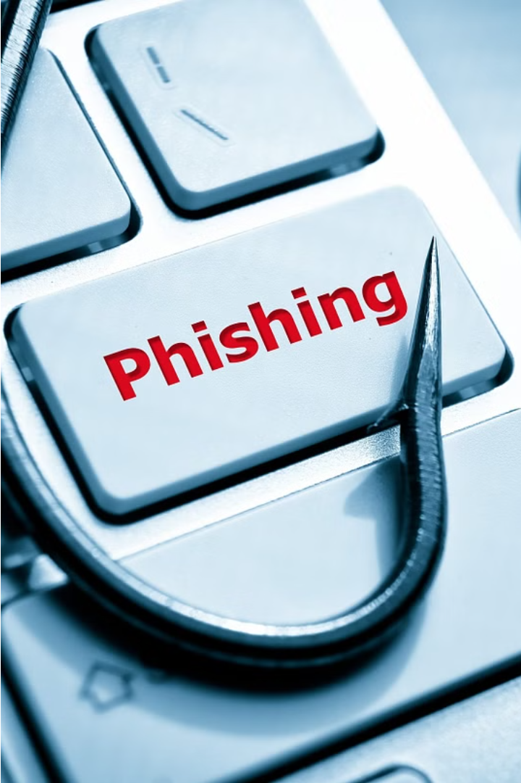
Understanding and
Preventing Phishing Attacks
A Comprehensive Guide to
Recognizing and Avoiding Phishing
Tactics

Slide 2
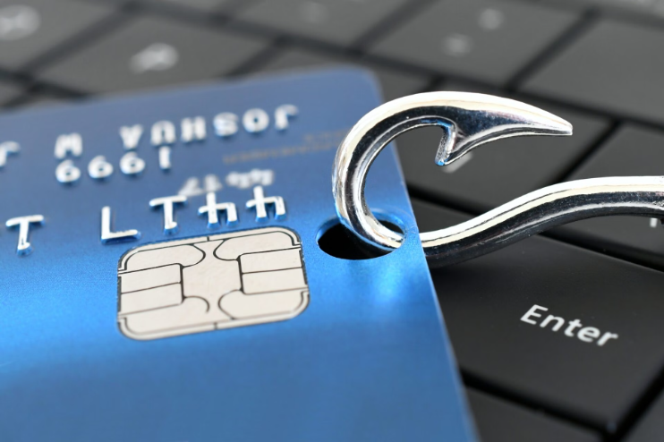
Introduction
Overview
What is phishing?
Importance of
awareness and education.

Slide 3
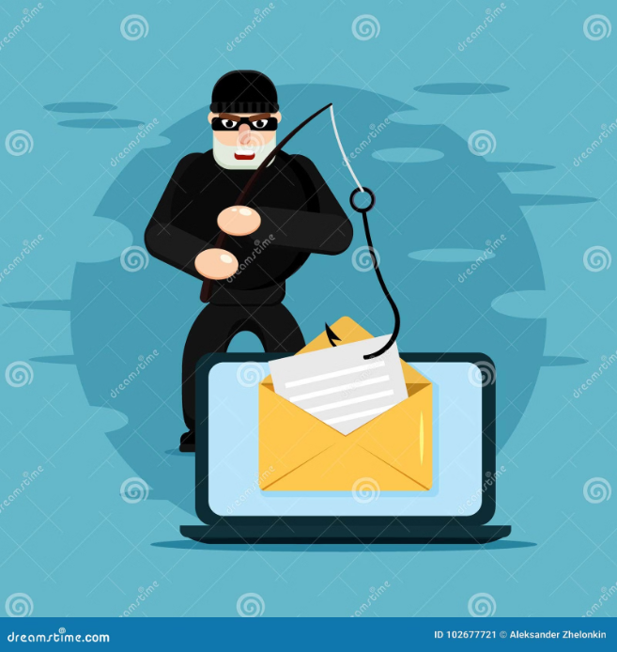
What is phishing?
Phishing is a type of cyber attack where criminals attempt to trick individuals into revealing,
sensitive information, such as login credentials or financial data.
Raising awareness and educating the public about phishing is crucial to prevent these deceptive and damaging schemes.

Slide 4
What is Phishing [continue]
1
Agenda
2
Information Targeted
Type of cyber attack that uses disguised emails or websites to trick individuals into revealing personal information.
Phishers commonly target login credentials, credit card numbers, Social Security numbers, and other sensitive personal data that can be used for identity theft or financial fraud.
3
How it Works
Phishing attacks typically involve creating a fake email or website that appears to be from a legitimate organization, then using social engineering tactics to convince the victim to share their sensitive information.

Slide 5
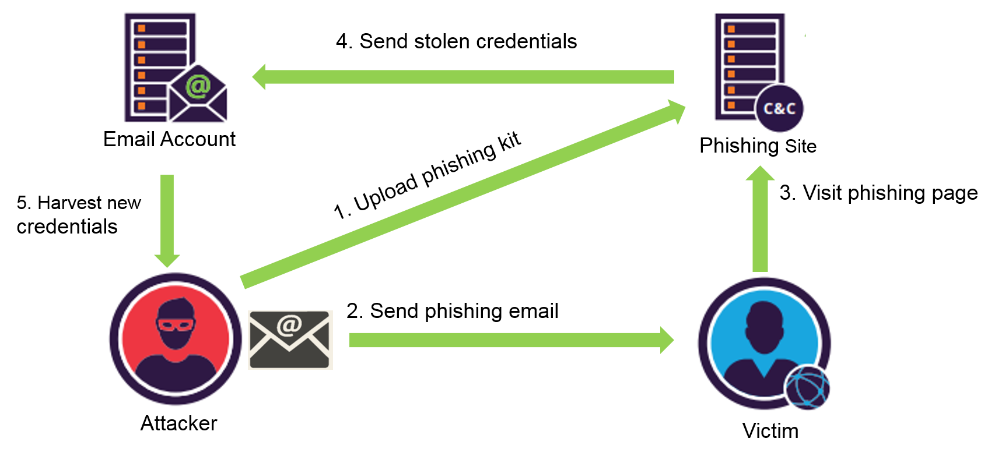
How it Phishing Works
Phishing attacks typically follow a common pattern. First, the attacker sends a fraudulent email or message that appears to be from a legitimate
source. The message may contain a malicious link or attachment that, when clicked, allows the attacker to gain access to the victim's sensitive information or system.

Slide 6




Common Phishing Techniques
Email Phishing
Spear Phishing
Whaling
Smishing and Vishing
Attackers create fake emails that appear to be from reputable sources, luring victims to malicious websites.
Targeted phishing attacks that use personal information to craft customized messages for specific individuals.
Phishing campaigns that specifically target high-profile individuals, such as CEOs and other executives.
Phishing attacks that use SMS text messages (smishing) or voice calls (vishing) instead of email.

Slide 7
Recognizing Phishing Emails
1
Suspicious Sender Address
2
Generic Greetings
Be wary of emails from addresses that don't match the purported sender or use lookalike domains (e.g. "support@compnay.com" instead of "support@company.com").
Phishing emails often use generic salutations like "Dear Customer" instead of your name, indicating an impersonal, mass-distributed message.
3
Urgent or Threatening Language
4
Misspellings and Errors
Phishers try to create a sense of urgency or fear to pressure you into acting quickly without thinking.
Poorly written emails with grammatical errors, typos, and incorrect formatting are common red flags of phishing attempts.

Slide 8
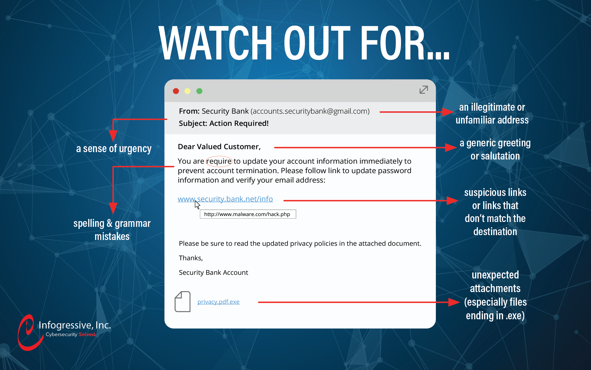
Email Phishing

Slide 9
How to Protect Yourself
Best Practice
Be Cautious
Verify Identity
Do not immediately trust unexpected communications.
Confirm the sender's identity before clicking on links or attachments.
Enable MFA
Keep Software Updated
Implement strong, unique passwords and multi-factor authentication.
Regularly update software and systems.

Slide 10



Reporting Phishing Attempts
Recognize Suspicious
Reporting
Investigate
Recognize the signs of a potential phishing attack.
Notify your organization's IT or security team about the suspicious email or message.
Let the professionals investigate and take appropriate action to mitigate the threat.

Slide 11
Implementing Awareness Training
1
Consistent Training
conduct monthly or quarterly sessions on the latest phishing tactics and best practices using live and recorded formats.
2
Simulated Phishing Tests
Use phishing simulation programs to send mock phishing emails, helping employees practice recognition and response.
3
Comprehensive Support:
Provide guides, checklists, and tutorials on phishing. Offer IT support for reporting suspicious activities.

Slide 12
Conclusion
1
2
3
Recap Key Points
Emphasize Vigilance
Final Thought
Summarize the main takeaways: recognizing phishing tactics, protecting personal information, and utilizing tools and resources effectively.
Highlight the need for ongoing awareness and continuous training to stay updated on new phishing threats.
Stay alert, stay secure. Protect your information.

